Slide 1
Scraping continued

Slide 2
Storing Data
This downloads the logo from http://pythonscraping.com and stores it as logo.jpg
in the same directory that the script is running from.

Slide 3
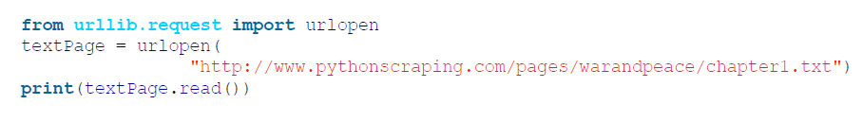
Reading Documents -Text

Slide 4
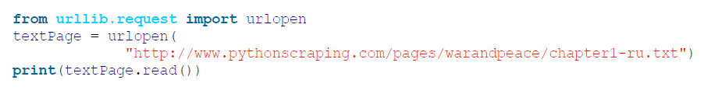
Encodings in action

Slide 5
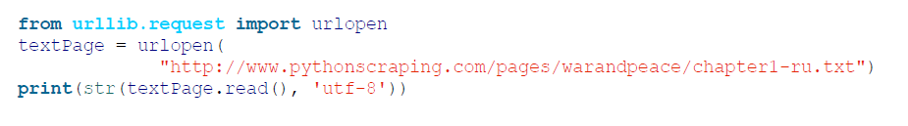
define the string to be UTF-8

Slide 6
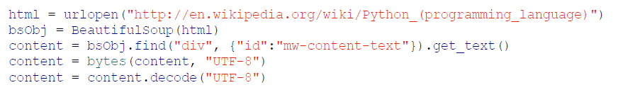
Using this concept in BeautifulSoup and Python 3.x

Slide 7

English-language sites, have the tag

Slide 8
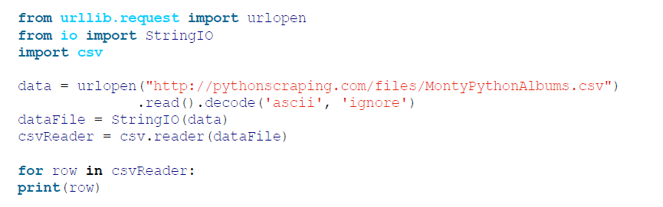
Reading CSV Files
script retrieves a
CSV file from the Internet (in this case, a list of Monty Python albums
at http://bit.ly/1QjuMv8) and prints it, row by row, to the terminal

Slide 9
Read
PDF
Microsoft Word and .docx

Slide 10
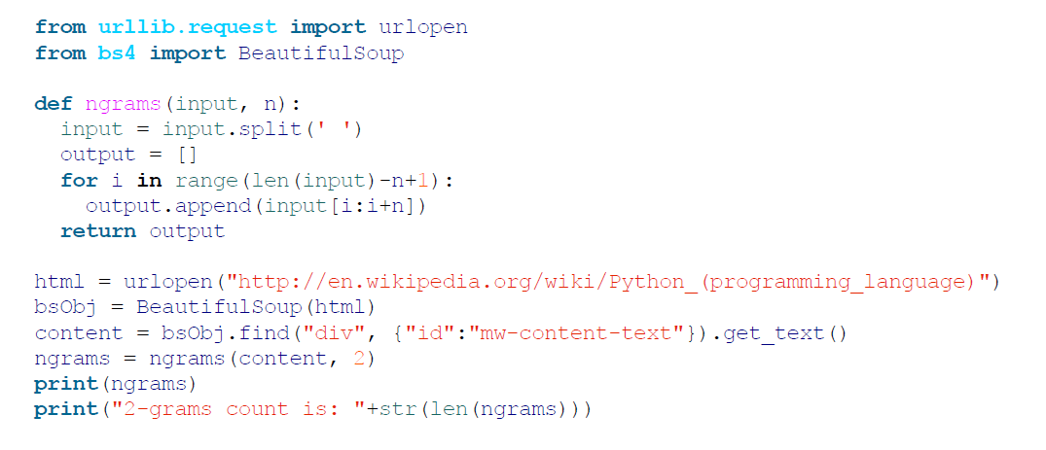
Advanced Scraping
return a list of 2-grams found in the Wikipedia article on the Python programming language

Slide 11
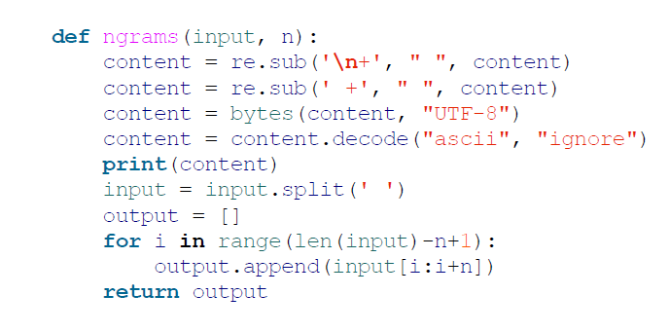
Cleaning Your Dirty Data

Slide 12
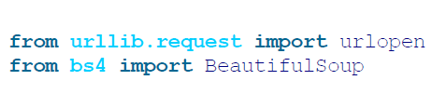
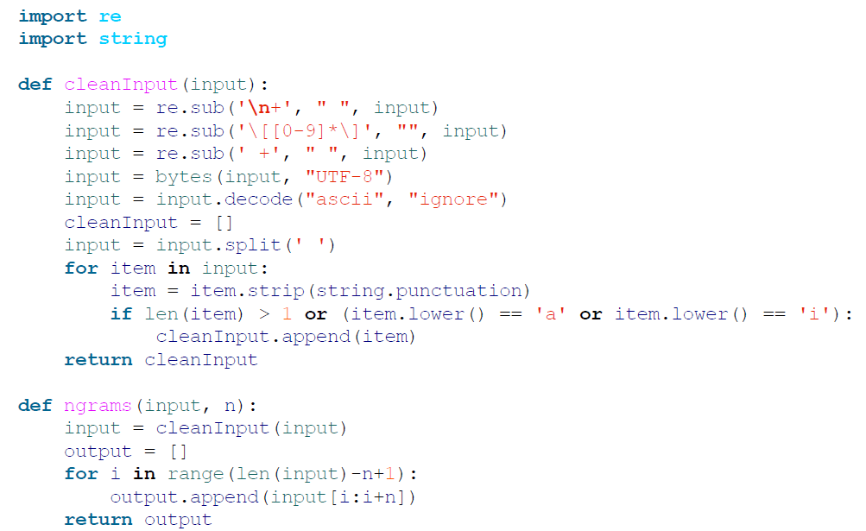
Further cleaning

